Slide 1


Bitcoin Price Prediction- an Analysis of Various Regression Methods
12th IEEE Symposium on Computer Applications & Industrial Electronics (ISCAIE 2022)
Authors:
Komal Soni, CSE student, Hyderabad Institute of Technology and Management
Dr Sugandha Singh, Dean IIIC, Hyderabad Institute of Technology and Management
Presented by:
Komal Soni
Submission id- 60 Presenter id- 16

Slide 2
AGENDA
Motivation
Literature Survey
Methodology
Data
Exploratory Data Analysis
Algorithms
Results
Conclusion
References

Slide 3
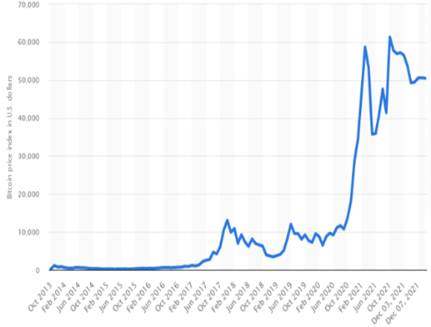
Motivation
Bitcoin is a fascinating area of research developed due to the rapid development of financial technologies. It is the fastest growing cryptocurrency.
The motivation behind this paper is to predict bitcoin prices with high accuracy using various regression-based models.
We have seen drastic changes in bitcoin prices over time accounting for its volatile nature.
Being able to predict the price of bitcoin with high accuracy will help an individual making an informed decision before investing in bitcoin.

Slide 4
Literature Survey
Hamayel et al tests LSTM, GRU, bi-LSTM models performance on three different cryptocurrencies Bitcoin, Litecoin, and Ethereum and proved that the best model in prediction for all types of cryptocurrencies is the GRU.
Miura R. et al uses Realized volatility time series analysis for models like ANN, Multi-Layer Perceptron, GRU, LSTM, SVM, and ridge regression to predict bitcoin prices and compares the results with Auto-Regressive Realized Volatility. Their study summarizes that ridge regression performs better than all the other tested models.
Mallqui et al uses RNN and tree classifier combined for prediction and SVM for forecasting provided the best results.
The work of Patrick Jaquart et al includes various feature sets like technical, blockchain-based, sentiment-/interest-based, and asset-based features to analyse that Recurrent Neural Networks and gradient boosting classifier performs best among various models and also proves that technical features are the best suitable feature set for prediction of bitcoin price.
S. McNally et al , predicts bitcoin price based on various models like Bayesian optimised RNN, ARIMA and LSTM. The outcomes of their study proves that LSTM outperforms all models and ARIMA forecast cannot outperform any non-linear deep learning model.
So far, no research work tests all general categories of regressors for bitcoin price prediction. Hence, in this study aims at testing eleven different regression-based models for prediction of bitcoin prices to identify best regression based model with highest possible accuracy.

Slide 5
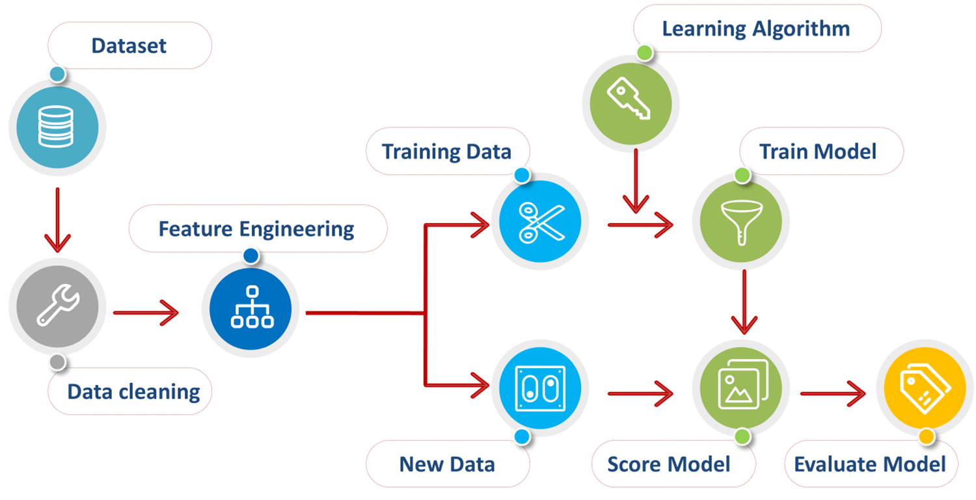
Methodology

Slide 6
Data
The data used for building machine learning models is real-time data collected using an API key from coinmarketcap.com. This API key provides data from 3, January 2009 to the present date. The dataset contains values like the date (UNIX timestamp), open (USD), high (USD), low (USD), close (USD), and volume (USD).
Cleaning of data by dropping NaN values.
Creating a new column Mean and using it as dependent variable indicating the average bitcoin price for the next day which is to be predicted.
Using MinMaxScaler for normalizing data.
Splitting data in 9:1 ratio for training and testing respectively.

Slide 7
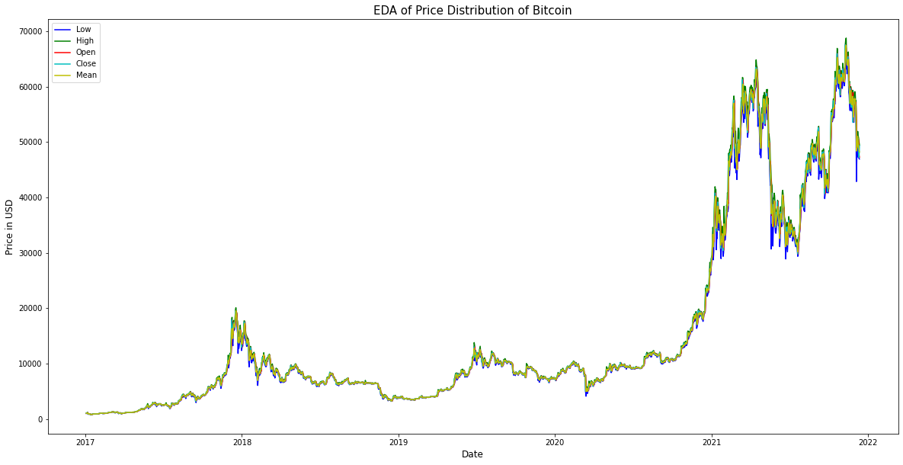
Exploratory Data Analysis

Slide 8
Algorithms
a) Extra tree regressor
It is a tree-based ensemble method for supervised regression problems. It fits several randomized decision trees on various sub-samples of the dataset. This algorithm provides accuracy and computational efficiency.
b) Gradient boosting machine regressor
Gradient Boosting Machine Regressor is a combination of two functionalities. First, steepest descent minimization, and second, stagewise additive expansion. It produces robust, interpretable, and competitive procedures. It is widely used for mining less than clean data.
c) Random Forest regressor
A combination of tree predictors is chosen as a random forest. As the number of trees in the forest increases, the generalization error converges to a limit as it depends on each of the trees in the forest and the correlation between them. This improves predictive accuracy and also helps control the overfitting problem.
d) Decision tree regressor
Decision Tree Regressor takes a dataset and keeps dividing the dataset. At each division of the dataset, an associated decision tree is built simultaneously. The outcome of such a process is a tree with nodes and leaf nodes.The decision tree regressor deals with continuous numeric values.

Slide 9
Algorithms
e) Linear regressor
Linear Regression provides a linear relationship between variables. The goal of the Linear Regression is to minimize the residual sum of squares errors, which is the linear approximation of the observed target and predicted target.
f) Light Gradient Boosting Machine regressor
LGBM Regressor is a leaf-wise expansion algorithm. The selection of leaf nodes is made so as to maximize delta loss. This helps in reducing losses and improves accuracy. The 'Light' in LGBM regressor accounts for its high-speed computation with lower memory requirements to run. LGBM regressor is used to work with large datasets, in smaller datasets, the LGBM regressor suffers from overfitting.
g) Extreme Gradient Boosting regressor
XGBoost regressor like gradient boosting regressor is also a combination of two functionalities.XGBoost Regressor implements randomization techniques. The goal here is to reduce the computational complexity required to determine the best split.
h) Stochastic Gradient Descent Regressor
Stochastic Gradient Descent Regressor uses online feature selection and computes the gradient of the loss of the sample and updates the model hence reducing the learning rate eventually consuming lesser time compared to other batch processing algorithms. It is also efficient, and easy to implement.

Slide 10
Algorithms
i) Kernel Ridge Regressor
Kernel Ridge Regressor chooses independent variables as regressors and performs ridge regression with a potentially infinite number of non-linear transformations. The model operates in high dimensions by computing the inner products between all pairs of data in the feature space of the dataset. Kernel Ridge Regression is widely used for pattern analysis.
j) Bayesian Ridge Regressor
Bayesian Ridge Regressor is a probabilistic approach to the regression model. It allows regularization of parameter tuning based on the chosen dataset which is obtained by including uninformative priors over the hyperparameters of the model. Regularization of the model is obtained by maximizing the log marginal likelihood. Instead of setting precision manually, Bayesian Ridge Regression allows the use of gamma distribution to set precision based on the dataset under consideration.
k) Support Vector Machine Regressor
Support vector machine regression is a regression model which is non-parametric. The regression hyperplane in support vector machine regression is obtained by optimizing support vectors which consist of distance from the nearby data points. ϵ-insensitive loss instead of quadratic loss is used to measure the empirical error in support vector machine regression. Support vector machine regression uses the sequential minimal optimization method to minimize the cost function.

Slide 11
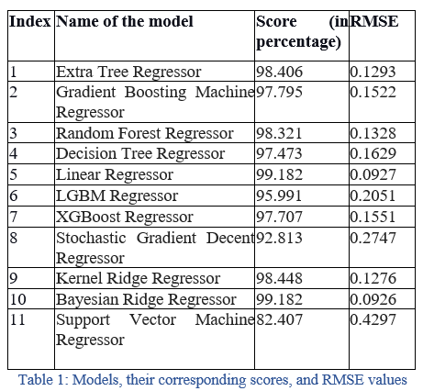
Results
Models are trained and tested over dataset.
Evaluation criteria used is RMSE and Accuracy Score
From the table it is evident that, Bayesian Ridge Regressor and
Linear Regressor performs better than all other models with
accuracy Score 99.182% and RMSE value 0.093.

Slide 12
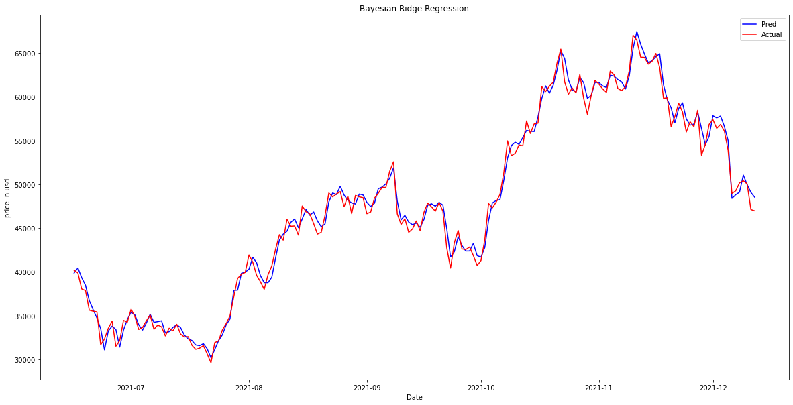
Results

Slide 13

Results

Slide 14
Conclusion
In this study, we predict the price of bitcoin using eleven different regression-based techniques
Used RMSE and accuracy score as metrics, and evaluated all the models and obtain promising results with accuracy scores as high as 99.182 and RMSE scores as good as 0.09264 obtained by Bayesian ridge regressor.
Linear regressor also provided metrics very close to Bayesian ridge regressor.
The accuracy score of 82.406 and RMSE score of 0.429 for Support Vector Machine Regressor are the least obtained values among all the models.
Hence, we can conclude that all the regression-based models perform extraordinarily well for predicting the price of bitcoin.

Slide 15
References
1. Böhme, Rainer, Nicolas Christin, Benjamin Edelman, and Tyler Moore. 2015. "Bitcoin: Economics, Technology, and Governance". Journal of Economic Perspectives, 29 (2): 213-38.
2. DeVries, Peter, (2016). An Analysis of Cryptocurrency, Bitcoin, and the Future. International Journal of Business Management and Commerce. Vol. 1. Pages 1-9.
3. Xu, M., Chen, X. & Kou, G. A systematic review of blockchain. Financ Innov 5, 27 (2019).
4. Kayal, P., & Rohilla, P. (2021). Bitcoin in the economics and finance literature: a survey. SN business & economics, 1(7), 88.
5. Araghinejad S. (2014) Regression-Based Models. In: Data-Driven Modeling: Using MATLAB in Water Resources and Environmental Engineering. Water Science and Technology Library, vol 67. Springer, Dordrecht.
6. Hitam, N.A.; Ismail, A.R. Comparative Performance of Machine Learning Algorithms for Cryptocurrency Forecasting. Indones. J. Electr. Eng. Comput. Sci. 2018, 11, 1121–1128.
7. Hamayel, M.J.; Owda, A.Y. A Novel Cryptocurrency Price Prediction Model Using GRU, LSTM and bi-LSTM Machine Learning Algorithms. AI 2021, 2, 477–496.
8. Miura R., Pichl L., Kaizoji T. (2019) Artificial Neural Networks for Realized Volatility Prediction in Cryptocurrency Time Series. In: Lu H., Tang H., Wang Z. (eds) Advances in Neural Networks – ISNN 2019. ISNN 2019. Lecture Notes in Computer Science, vol 11554. Springer, Cham.
9. Mallqui, D.C.A., Fernandes, R.A.S.: Predicting the direction, maximum, minimum and closing prices of daily Bitcoin exchange rate using machine learning techniques. Appl. Soft Comput. 75, 596–606 (2019)
10. Patrick Jaquart, David Dann, Christof Weinhardt,Short-term bitcoin market prediction via machine learning, The Journal of Finance and Data Science, Volume 7, 2021, Pages 45-66, ISSN 2405-9188, .
11. S. McNally, J. Roche and S. Caton, "Predicting the Price of Bitcoin Using Machine Learning," 2018 26th Euromicro International Conference on Parallel, Distributed and Network-based Processing (PDP), 2018, pp. 339-343,.

Slide 16
Thank You

